Slide 1
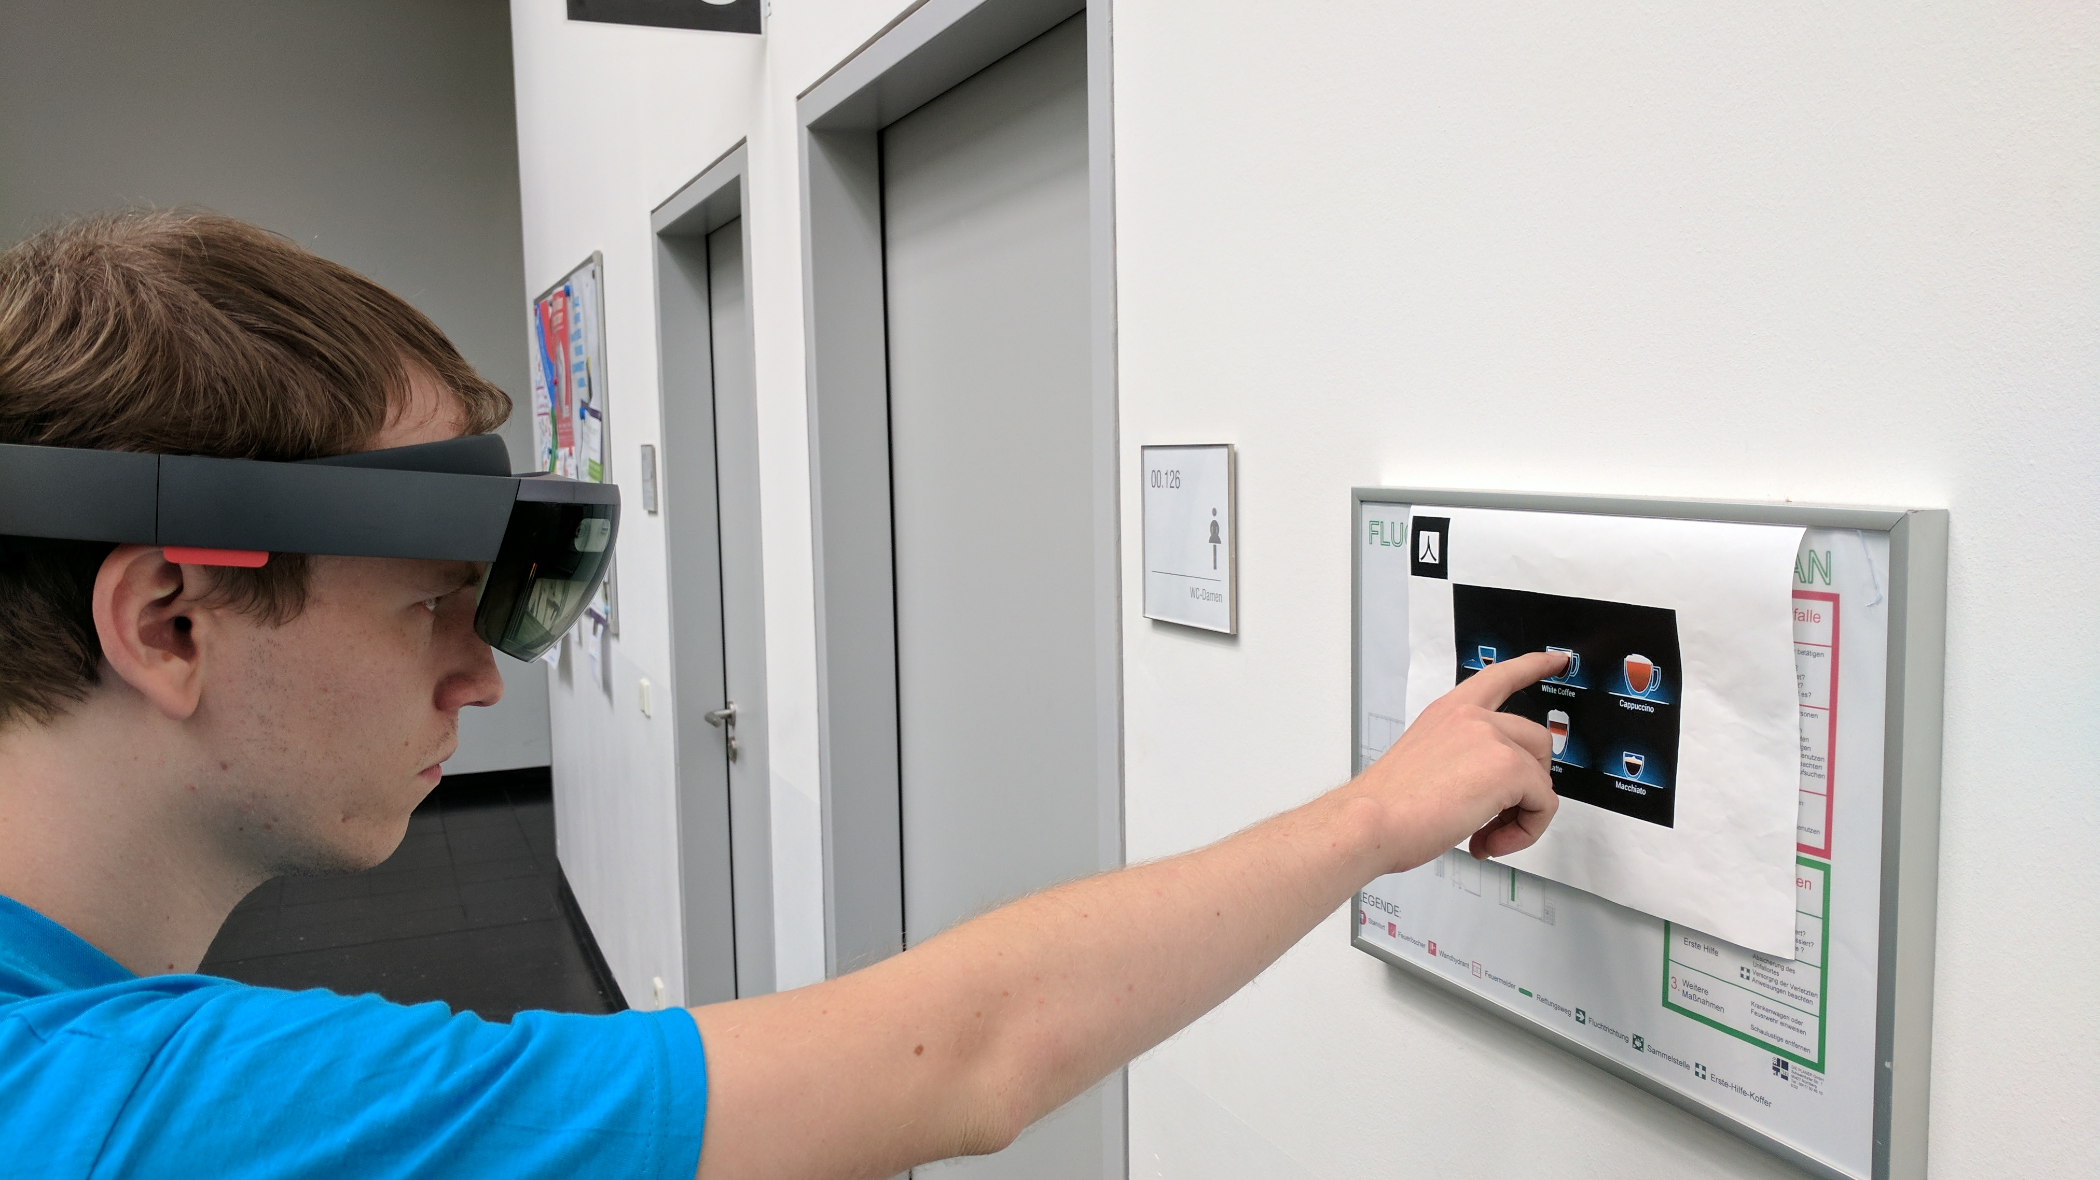
BlindAR
– Augmenting the reality of visually impaired

Slide 2
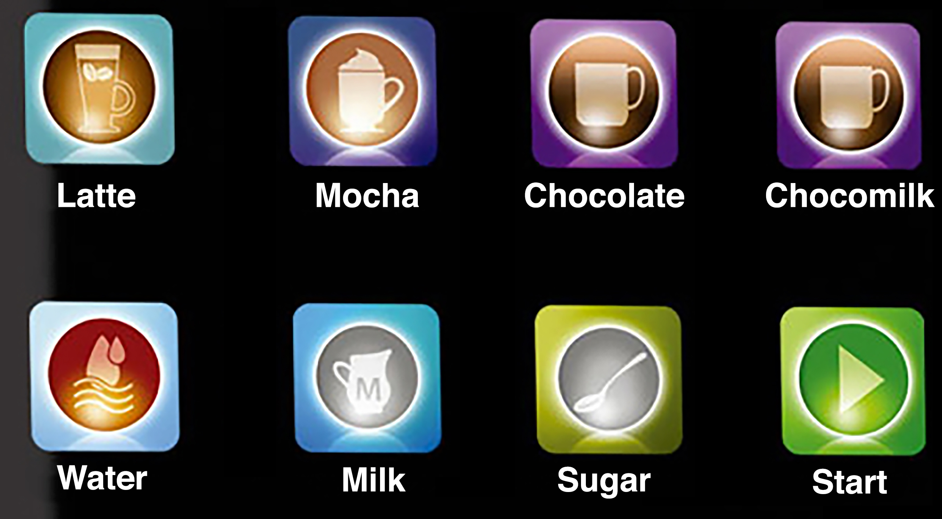
Motivation
Solve the problem of touchscreen accessibility for blind people by scanning and overlaying touchscreen displays in 3D

Slide 3
Motivation
“Latte”
Solve the problem of touchscreen accessibility for blind people by scanning and overlaying touchscreen displays in 3D
Touchscreen

Slide 4
Pipeline
Scan touchscreen interface
Map buttons to virtual elements
Track finger position
Voice feedback if finger hovering over one button
Map finger position to touchscreen buttons

Slide 5
Materials
Microsoft Hololens:
RGB and Depth cameras mounted to the head => aligned with gaze direction
Microsoft Cognitive Services – Vision API:
Optical Character Recognition for User Interface

Slide 6
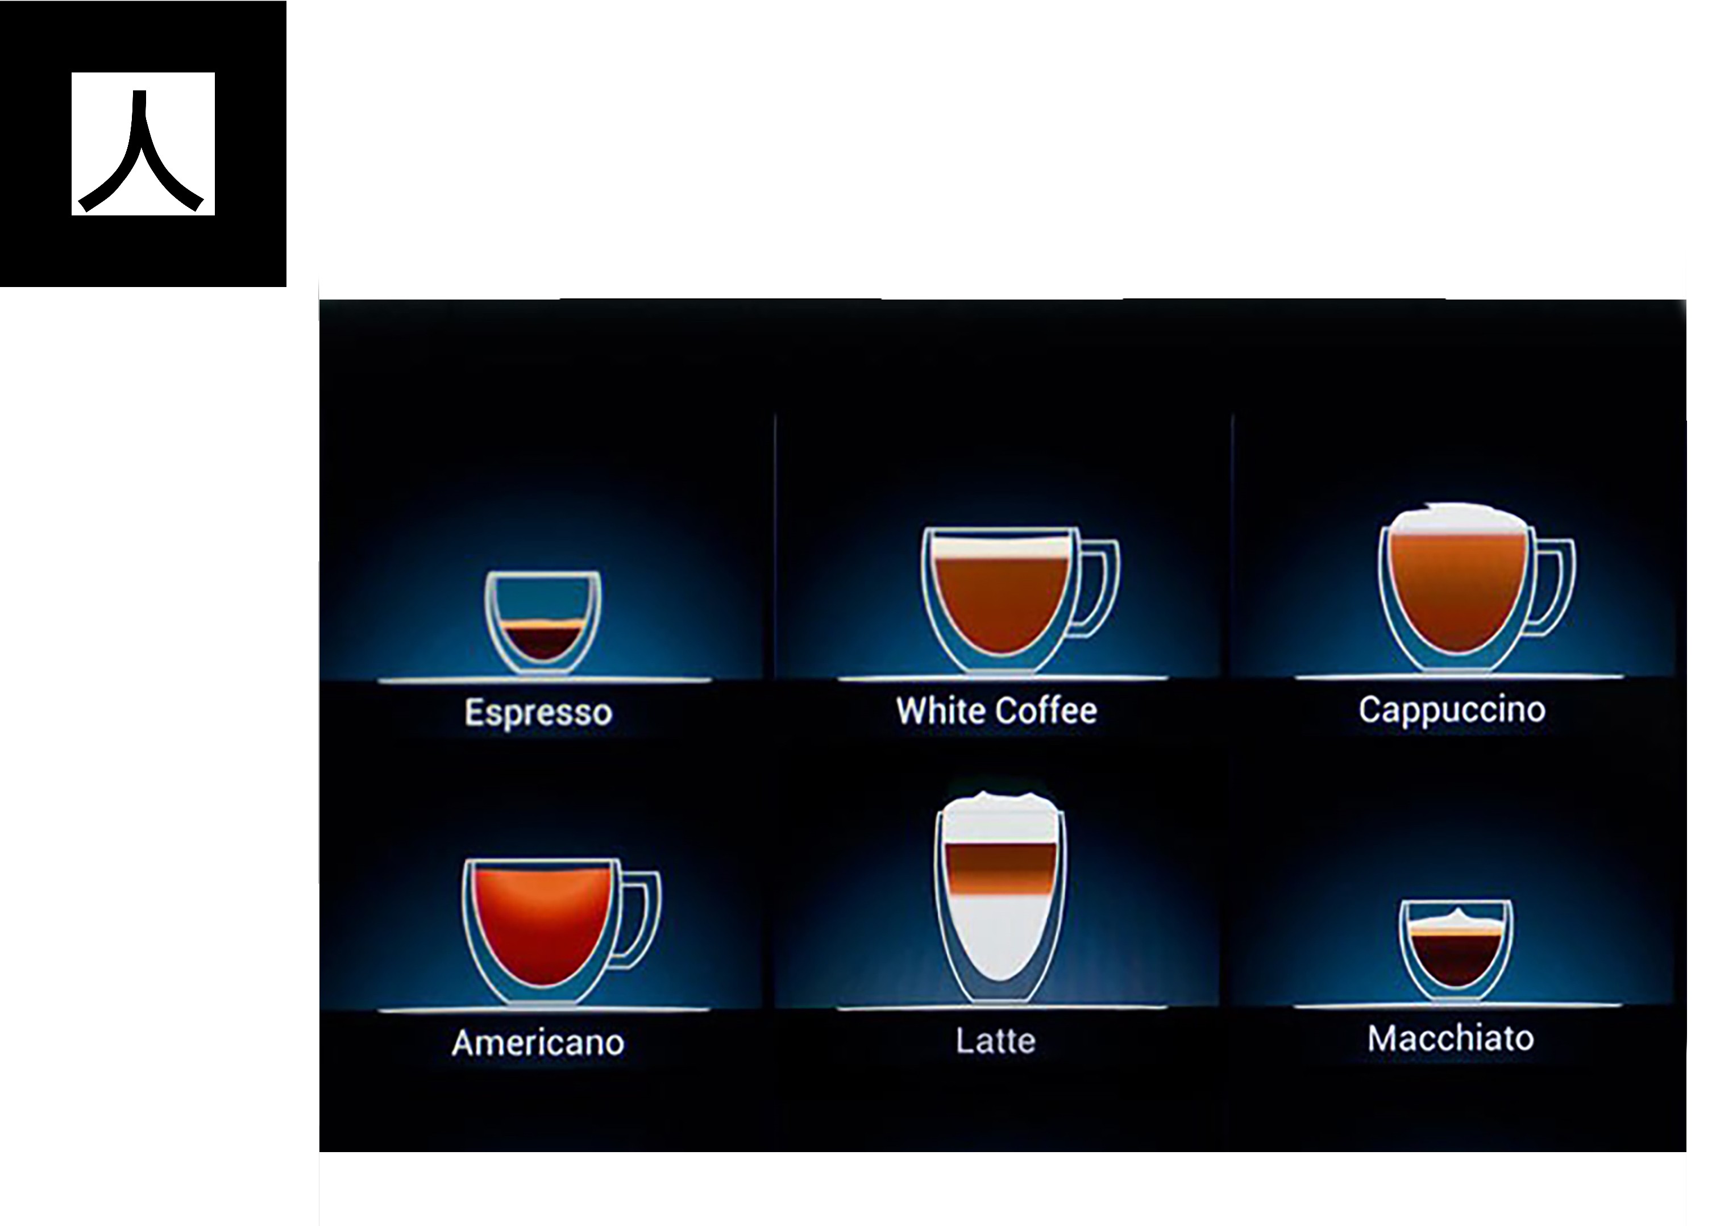
UI Augmentation
Marker-based, specific per device model
UI known

Slide 7
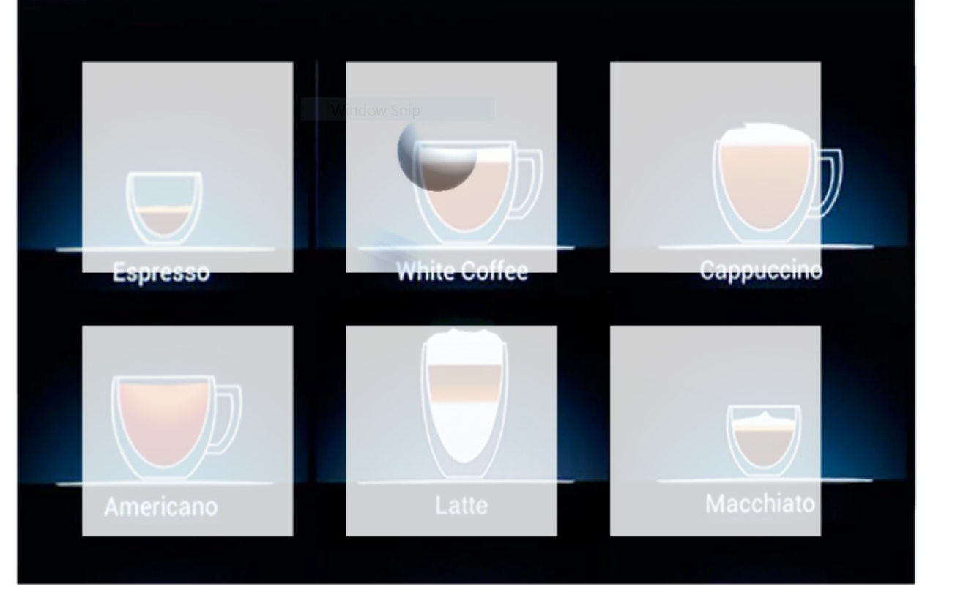

Slide 8
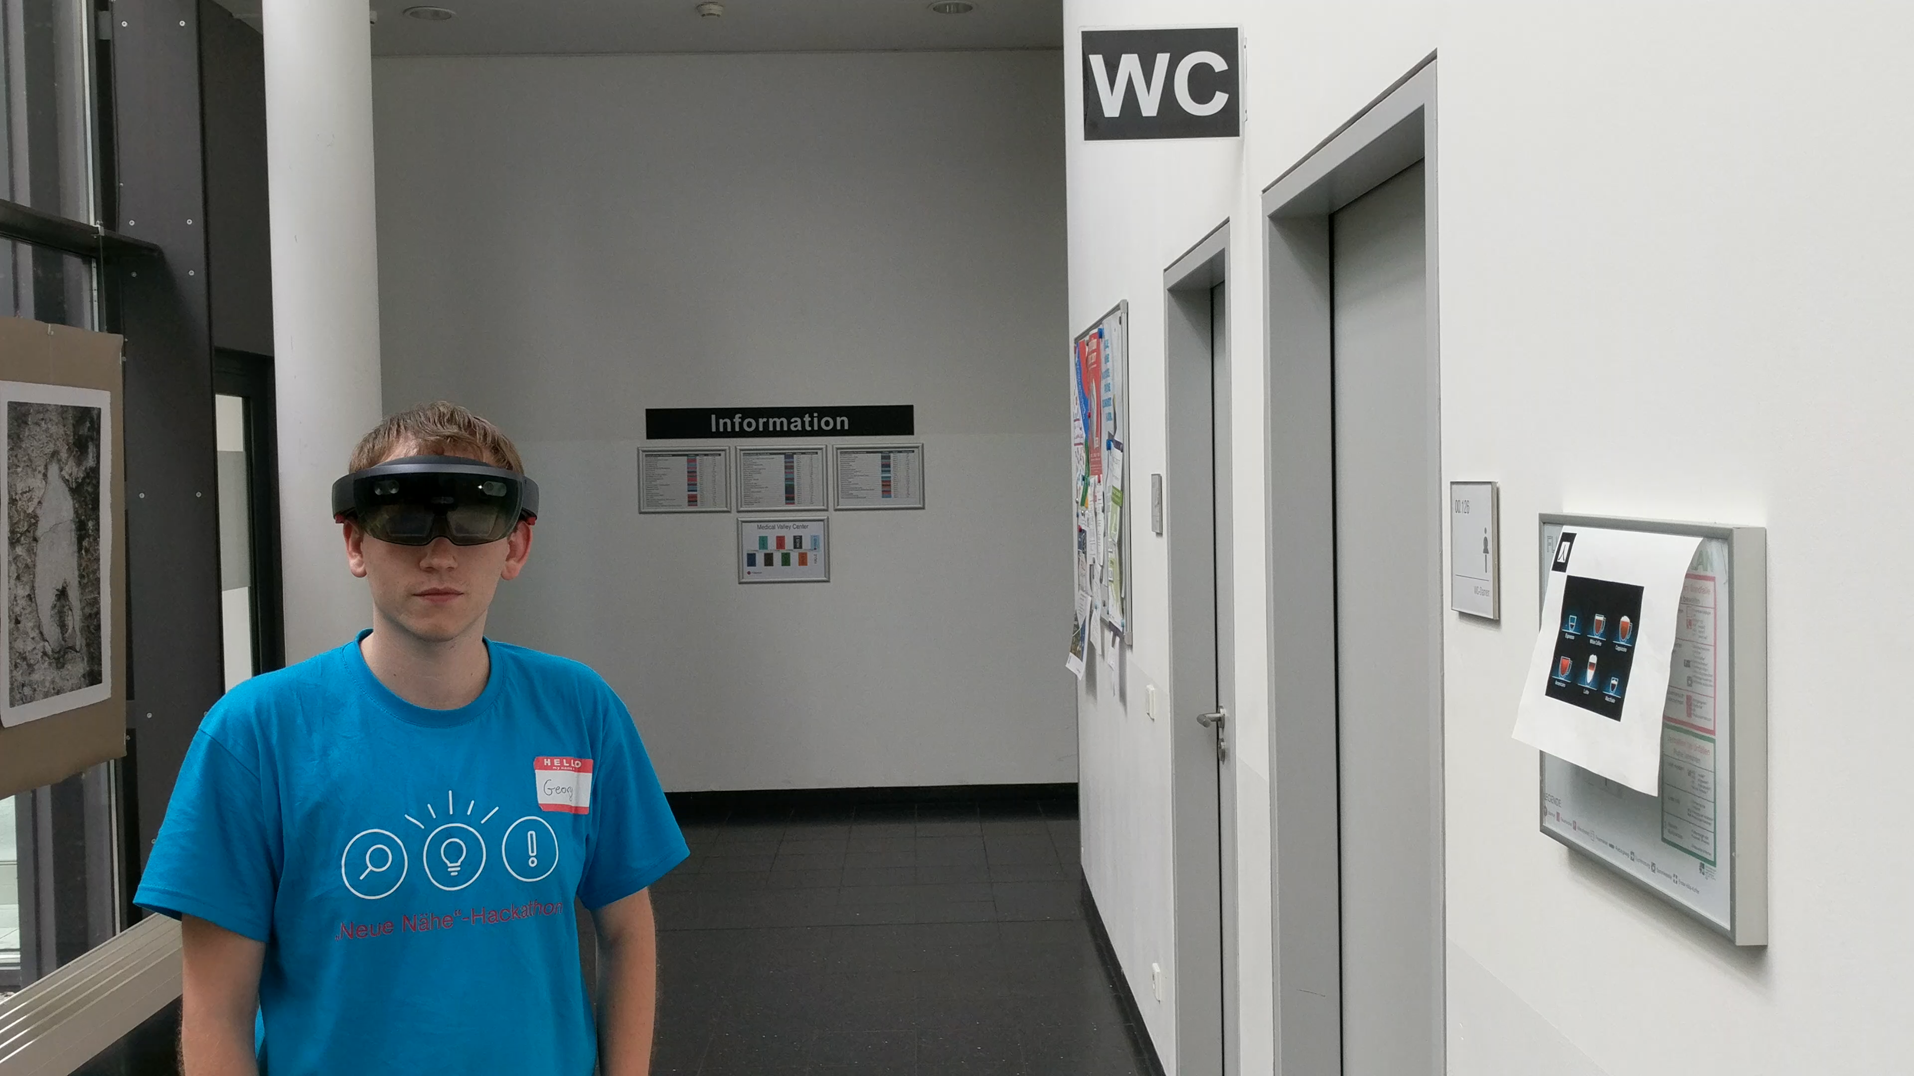

Slide 9
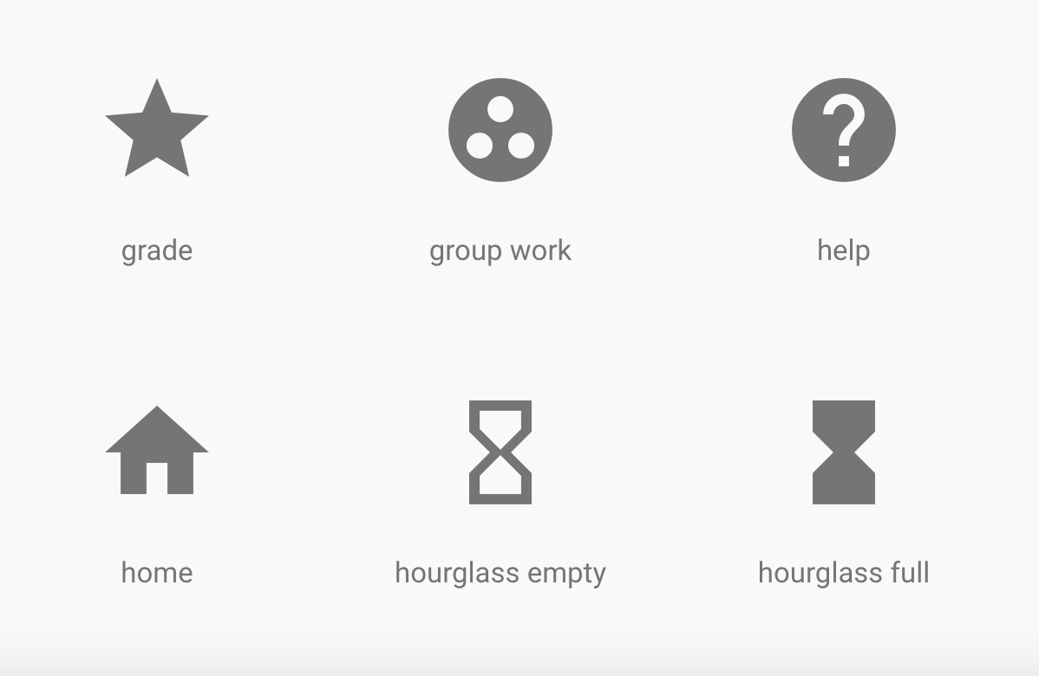
UI Recognition
If UI is not known
1st attempt: Tesseract OCR ☹
Vision API called from Python
OCR on user interface to identify labels
Automatically segment, align and group bounding boxes for each touch area
[
{'coords': [46, 275, 0], 'text': ' grade'},
{'coords': [47, 647, 316, 355], 'text': ' home'},
{'coords': [443, 275, 712, 0], 'text': ' group work'},
{'coords': [443, 647, 712, 355], 'text': ' hourglass empty'},
{'coords': [838, 275, 1108, 0], 'text': ' help'},
{'coords': [838, 647, 1107, 355], 'text': ' hourglass full'}
]

Slide 10
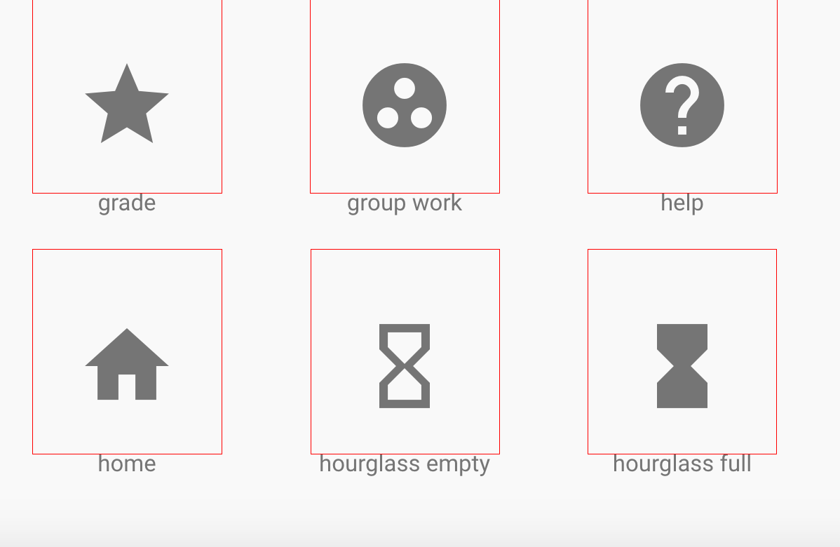
grade
group work
help
home
hourglass empty
hourglass full

Slide 11
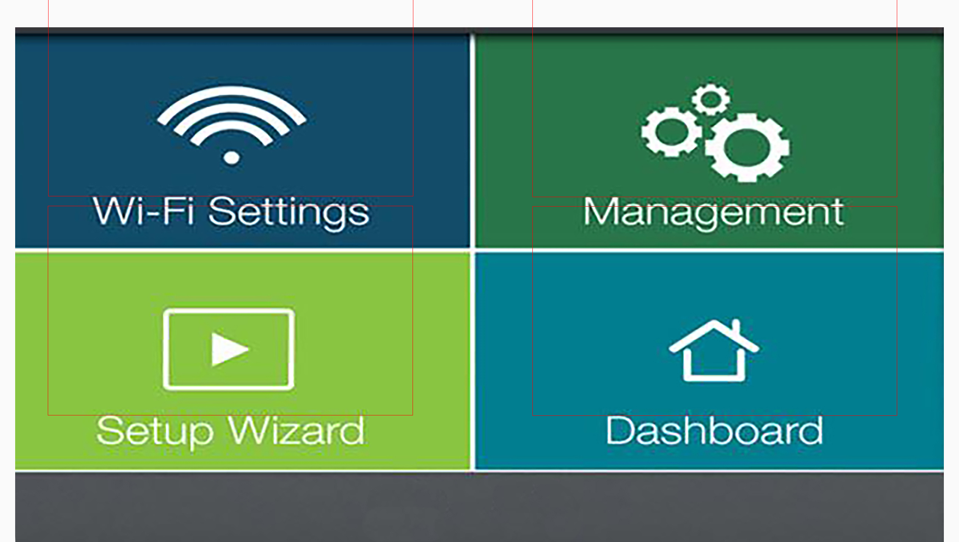

Slide 12
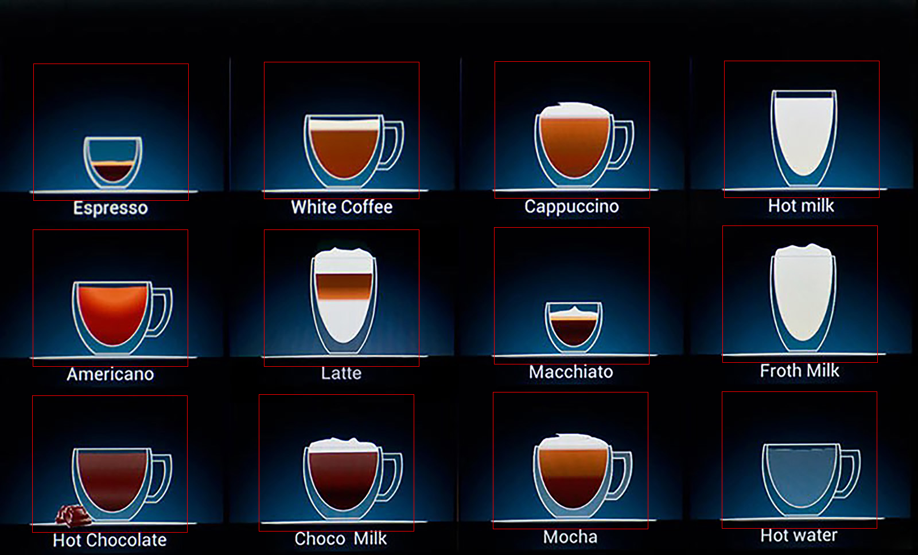

Slide 13


Slide 14
